Slide 1
Introduction to Autonomous Cloud with Keptn
Dynatrace PERFORM HOTDAY

Slide 2
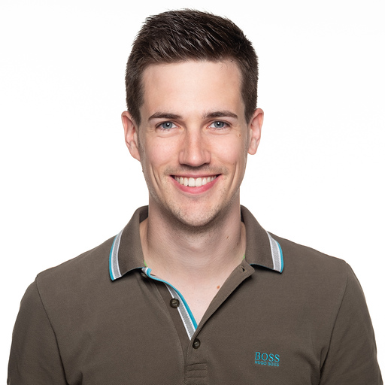

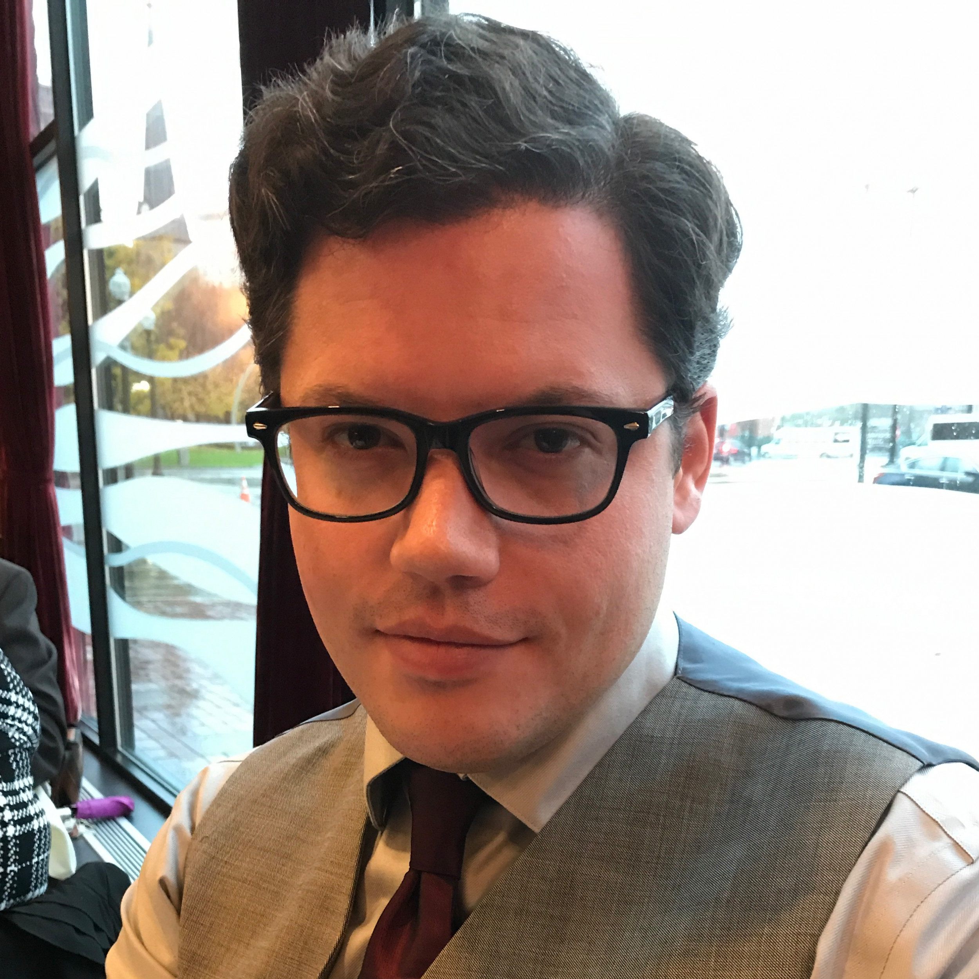
Introduction to Autonomous Cloud with Keptn
Andreas Grimmer
Technology Strategist
Dynatrace
Johannes Braeuer
Technology Strategist
Dynatrace
Dynatrace PERFORM HOTDAY
Jonathan Duggan
Autonomous Cloud Architect
Dynatrace

Slide 3
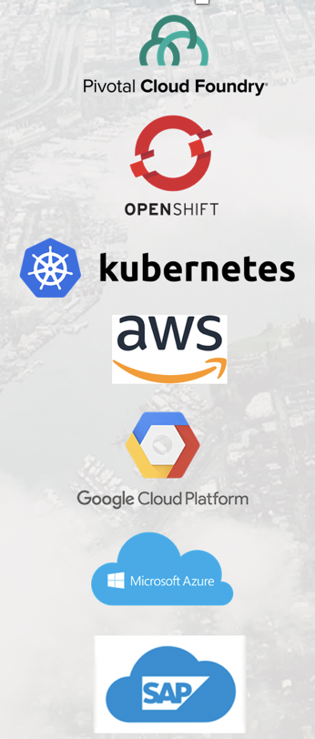







Your App / Container
Cloud Native: Deliver High
Quality Faster

Slide 4
Maturity Questions
Mean Time to Innovation (MTTI)
Are you on two-week sprints?​
Do you also release 25 times a year?​
How long does it take you to deploy a new release to production?​
Do you measure feature adoption?
Mean Time to Remediate (MTTR)
How long does it take to rollback/roll forward a faulty release?​
To release any software in your organization, how many manual steps does it take?​

Slide 5
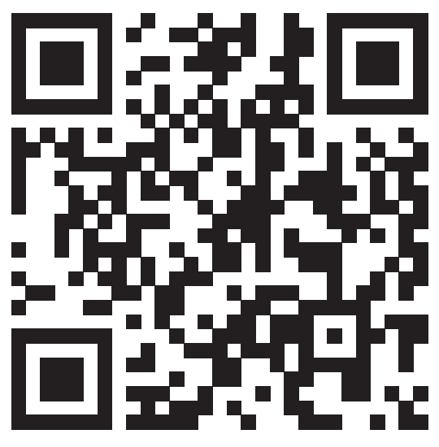
The reality and evidence supports the need for ACM! → https://dynatrace.ai/acsurvey
MTTR
Only < 5% are "Cloud Native“
~ 10min
4 hours
Take the Autonomous Cloud Survey!
4.8 days
MTTI
12.5 days
2 days
~ 1 hour

Slide 6
Building Blocks to become Cloud Native
Becoming Cloud Native
Increase Quality &
Level of Automation
AUTOMATE
OPERATIONS
Auto
Roll-Back
Adaptive
Scaling
Auto-Remediation
AUTOMATE
DEPLOYMENT
Blue / Green
Deployments
Canary
Releases
Dark Deployments
AUTOMATE
QUALITY
Automated Testing
Continuous Performance
Auto Quality Gates
AUTOMATE
MONITORING
Strategically Used as Pipeline Feature
Increase Speed &
Reduce Costs

Slide 7
Challenges to solve for becoming Cloud Native: Automate Quality
“
A project consists of x services
Unmanageable following a manual or semi-automated approach!
Each service is deployed y times per day
AUTOMATE
QUALITY
x * y quality checks are needed!
AUTOMATE
MONITORING

Slide 8
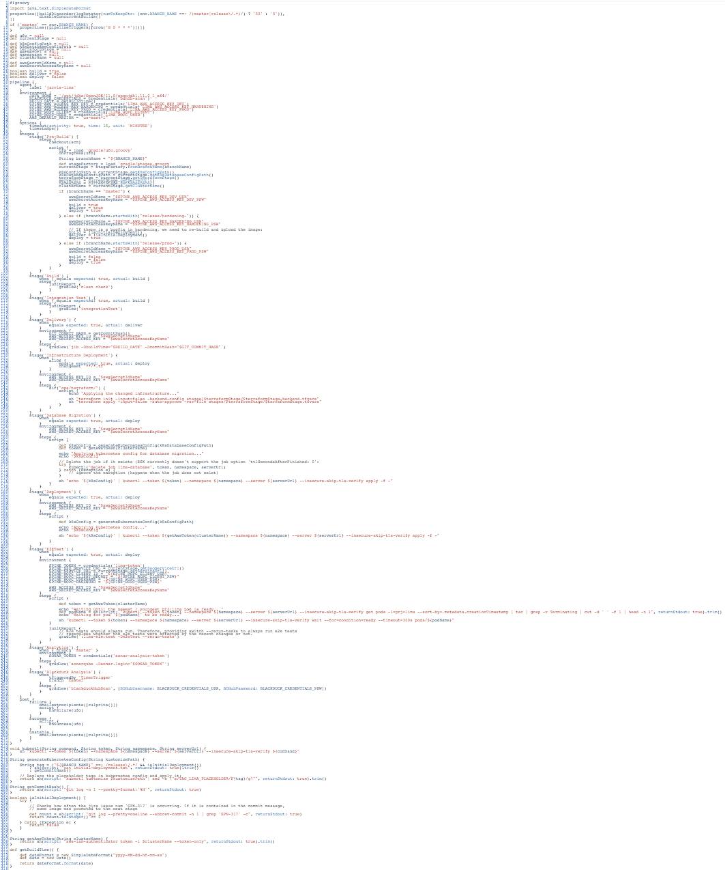
Challenges to solve for becoming Cloud Native: Automate Deployment
>350 LOC
Mixed information about
Process (deploy, test, evaluate, …)
Target platform (k8s, …)
Environments (dev, hardening, …)
Tools (Terraform, Helm, hey, …)
AUTOMATE
DEPLOYMENT
AUTOMATE
QUALITY
AUTOMATE
MONITORING
Jenkins Pipeline for CD

Slide 9

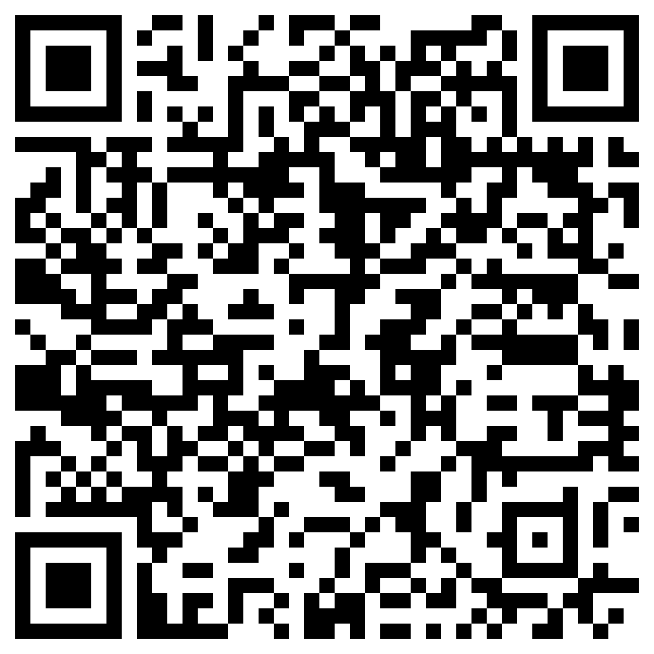
Challenges to solve for becoming Cloud Native: Automate Deployment
1 Service = 1 Pipeline
1 Project = x Pipelines
n Teams = n*x Pipelines
pipeline {
stages {
stage('Deploy to dev namespace') {
steps {
container(‘helm’) {
}
}
}
stage('Run tests') {
steps {
container(‘hey’) {
}
}
}
stage(‘Evaluate performance’) {
steps {
container(‘curl’) {
}
}
}
if (evaluation.passed) {
stage('Deploy to staging') {
steps {
container(‘helm’) {
}
}
}
}
}
}
pipeline {
stages {
stage('Deploy to dev namespace') {
steps {
container(‘helm’) {
}
}
}
stage('Run tests') {
steps {
container(‘jmeter’) {
}
}
}
stage(‘Evaluate performance’) {
steps {
container(‘curl’) {
}
}
}
if (evaluation.passed) {
stage('Deploy to staging') {
steps {
container(‘helm’) {
}
}
}
}
}
}
pipeline {
stages {
stage('Deploy to dev namespace') {
steps {
container(‘kustomize’) {
}
}
}
stage('Run tests') {
steps {
container(‘jmeter’) {
}
}
}
stage(‘Evaluate performance’) {
steps {
container(‘curl’) {
}
}
}
if (evaluation.passed) {
stage('Deploy to staging') {
steps {
container(‘helm’) {
}
}
}
}
}
}
“
Pipelines seem to be becoming our new future unmanageable legacy code!
AUTOMATE
DEPLOYMENT
pipeline {
stages {
stage('Deploy to dev namespace') {
steps {
container(‘helm’) {
}
}
}
stage('Run tests') {
steps {
container(‘jmeter’) {
}
}
}
stage(‘Evaluate performance’) {
steps {
container(‘curl’) {
}
}
}
if (evaluation.passed) {
stage('Deploy to staging') {
steps {
container(‘helm’) {
}
}
}
}
}
}
pipeline {
stages {
stage('Deploy to dev namespace') {
steps {
container(‘helm’) {
}
}
}
stage('Run tests') {
steps {
container(‘selenium’) {
}
}
}
if (evaluation.passed) {
stage('Deploy to staging') {
steps {
container(‘helm’) {
}
}
}
}
}
}
AUTOMATE
QUALITY
Further reading
AUTOMATE
MONITORING

Slide 10
Challenges to solve for becoming Cloud Native: Automate Operations
NUMBER OF ISSUES
BEFORE: mostly manual
AUTOMATE
OPERATIONS
“
MANUAL COMM
MANUAL COMMUNICATION
ENGAGE
TRIAGE
FIND & ASSEMBLE
RESOLVE
RESTORE
Before
We spend more time in manual communication than remediating issues!
AUTOMATE
DEPLOYMENT
AUTOMATE
QUALITY
AFTER: mostly automated
AUTOMATE
MONITORING
RESOLVE
RESTORE
After

Slide 11
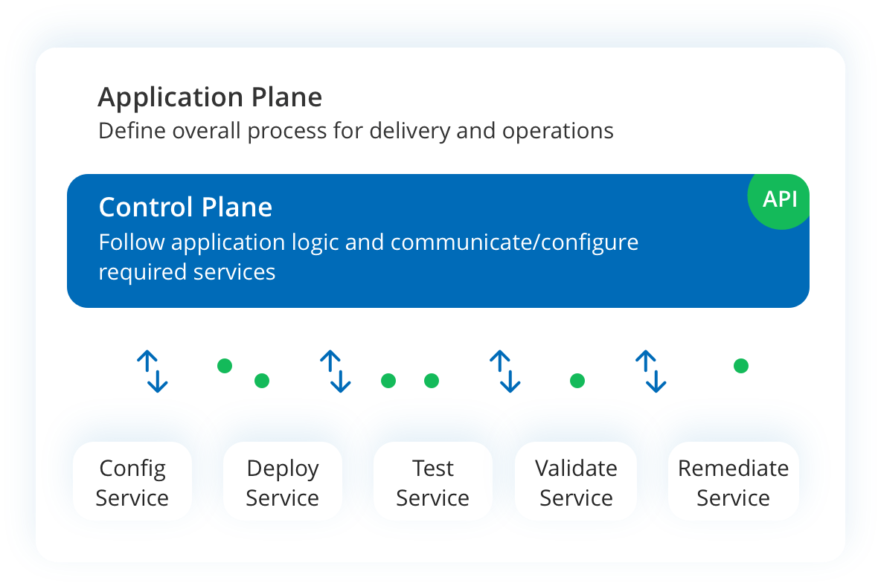
What is Keptn?
Keptn is an event-based control plane for continuous delivery and automated operations for cloud-native applications.

Slide 12


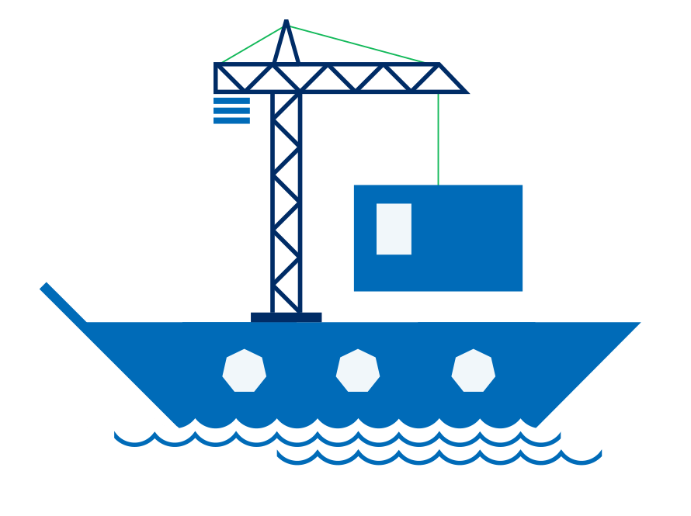
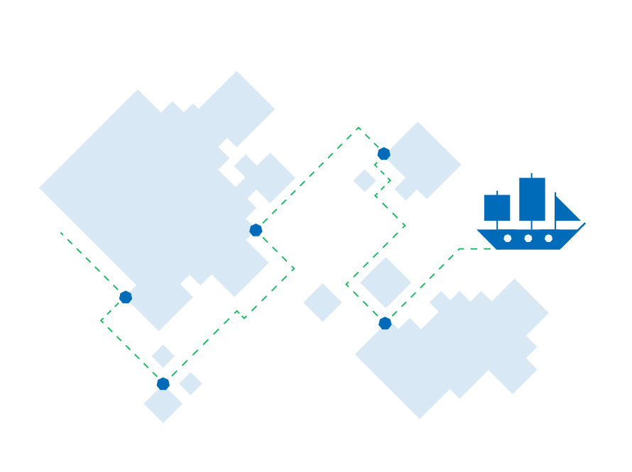
Why Keptn?
Scriptless delivery and operations
Declarative approach for delivery or operations automation
Share definitions across any number of microservices w/o individual pipelines and scripts
Separation of concerns
Processes defined by SREs
Tooling defined by DevOps
Artifacts defined by Devs
Event-based automation for extensibility
CloudEvents for all delivery and operations steps
Simple and fast integration by registering to those events
Built-in Observability
Built-in tracing capabilities for all deployments and operations flows
Visualization in the Bridge

Slide 13
Here is what we have prepared for you

Slide 14




HOT DAY Environment Overview
GKE Cluster
Shell in a box
Access Shell via Web
Your Laptop
Bastion Host

Slide 15
Let’s prepare your HOT DAY Environment
Every Participant has their own Dynatrace Tenant (should be on your card)
TenantUrl: https://abc11111.sprint.dynatracelabs.com
User/Pwd: studentXYZPerform2020@trial.dynatracelabs.com / Dyn@trac3
Every participant has their own GKE Cluster
The required CLI tools are already installed on the Bastion Host
Every Participant can access the Bastion Host via a Browser (e.g. Chrome)
ShellInABox URL: https://34.94.46.35/shell
User/Pwd: hotuserX / dynatraceperform
Browse to the HOT DAY Git Repository for detailed instructions:
https://github.com/keptn-workshops/getting-started

Slide 16
Setup
https://github.com/keptn-workshops/getting-started

Slide 17
Shipyard: Declarative Description of Environment and Deployment
shipyard.yaml
stages:
- name: "dev"
deployment_strategy: "direct"
test_strategy: "functional"
- name: "staging"
deployment_strategy: "blue_green_service"
test_strategy: "performance"
- name: "production"
deployment_strategy: "blue_green_service”
remediation_strategy: "automated"
One segment per
environment stage
Deployment strategy: blue_green_service
Test strategy: performance
Deployment Strategies:
"direct" replaces existing deployment
"blue_green_service" provides a new deployment next to the old one
Test Strategies:
Scripts stored in <repo>/jmeter
"functional" uses JMeter to execute <repo>/jmeter/basiccheck.jmx
" performance" uses JMeter to execute <repo>/jmeter/load.jmx

Slide 18






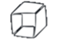



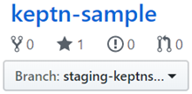
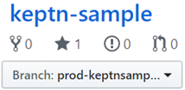
Create Project:
$ keptn create project keptn-sample –shipyard=shipyard.yaml
Config
ChatOps
IT Autom
Deploy
Test
Observe
STAGING
C
Update
D
Blue/Green
C
Update
D
Blue/Green
PROD

Slide 19
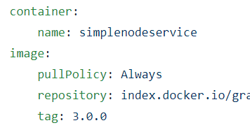
Onboard Service:
$ keptn onboard service myservice --project=… --chart=…
Config
ChatOps
IT Autom
Deploy
Test
Observe
STAGING
C
Update
D
Blue/Green
PLACEHOLDER
C
Update
D
Blue/Green
PROD
PLACEHOLDER

Slide 20
Exercise 1: Onboarding the simplenode Service
https://github.com/keptn-workshops/getting-started/tree/master/01_Onboarding_simplenode_service

Slide 21
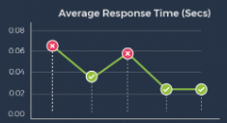
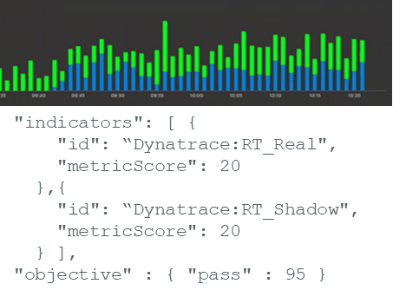

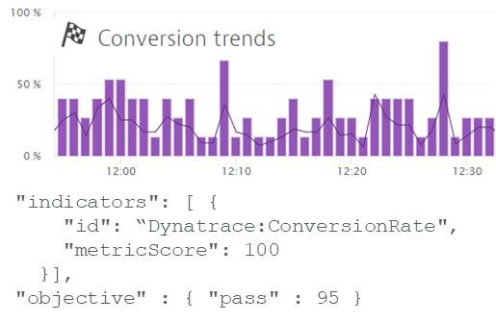

Deploy Artifact v5.0.1:
$ keptn send event new-artifact myservice:5.0.1
Config
ChatOps
IT Autom
Deploy
Test
Observe
C
Update
D
Blue/Green
T
Performance
O
STAGING
Score
Promote?
PROMOTE
1
83
/
100
PLACEHOLDER
5.0.1
C
D
T
Score
Keep?
Update
Blue/Green
O
PROD
KEEP
1
75
/
100
PLACEHOLDER
5.0.1

Slide 22
Exercise 2: Deploying the simplenode Service
https://github.com/keptn-workshops/getting-started/tree/master/02_Deploying_simplenode_service

Slide 23


Quality Gates
In cloud-native environments, full automation of quality gates is a must-have!
Service Level Indicators (SLIs) define relevant indicators for the service
Metrics: response time, error rate, CPU usage, …
Infrastructure: architecture constraints, …
Business: Conversion rates, user satisfaction, …
Service Level Objectives (SLOs) define objectives using the SLIs
Compare against fixed thresholds
Compare against previous versions of the service
Keptn’s Lighthouse
evaluates SLOs
queries SLIs from
Dynatrace
Prometheus
Neotys

Slide 24
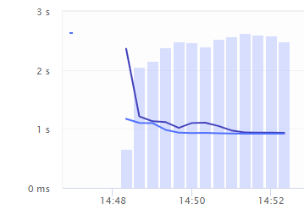
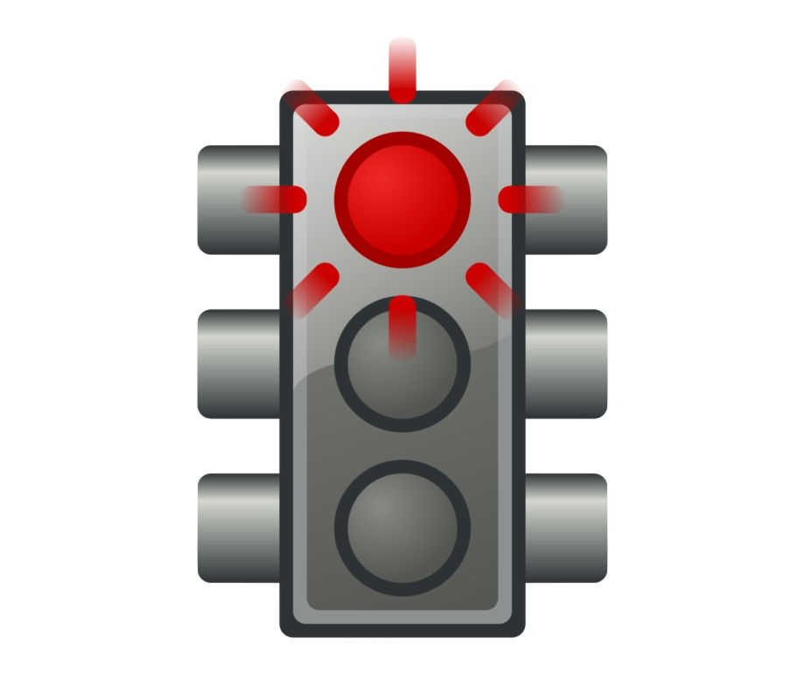
Example: Service Level Objectives
spec_version: "1.0"
comparison:
compare_with: "single_result"
objectives:
- sli: response_time_95
pass:
- criteria
- "<200"
warning:
- criteria
- "<500"
- sli: sql_statements
pass:
- criteria:
- "=0%"
warning:
- criteria:
- "<+5%"
- ">-5%"
total_score:
pass: "90%"
warning: "75%"
Source
Grading
Example
Strategy
Response Time
# other possible options: # compare_with: "several_results"
SLI
500
<200: 1
Value: 400
Criterion
200
<500: 0.5
Score: 0.5
SQL Statements
SLI
=0%: 1
+5%
<+5%: 0.5
Value: +3%
Criterion
-5%
>-5%: 0.5
Score: 0.5
Scoring Objective
Total
1/2 (50%)

Slide 25
Deploy artifact v5.0.2:
$ keptn send event new-artifact myservice:5.0.2
Config
ChatOps
IT Autom
Blue/Green
Deploy
Test
Observe
Quality gate stopped bad artifact to reach production!
C
Update
D
Blue/Green
T
Performance
O
STAGING
Score
Promote?
ABORT
1
67
/
100
2
5.0.1
5.0.2
C
D
T
Score
Keep?
Update
Blue/Green
O
PROD
1
5.0.1

Slide 26
Exercise 3: Exploring Keptn's Quality Gates
https://github.com/keptn-workshops/getting-started/tree/master/03_Exploring_quality_gates

Slide 27



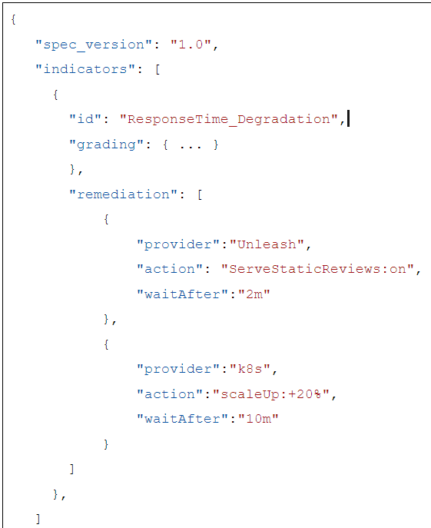
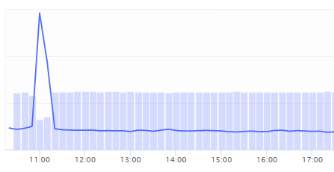
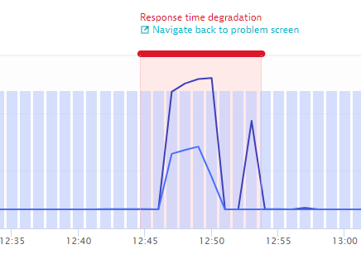

Self-Healing Production:
Dynatrace sends a problem event to Keptn
Config
ChatOps
IT Autom
Deploy
Test
Observe
Decide
Notify
PROD
4
4
Evaluate
4
Escalate
Act

Slide 28
Exercise 4: Automatic remediation actions with Keptn
https://github.com/keptn-workshops/getting-started/tree/master/04_Automatic_remediation

Slide 29
We are building keptn to re-shape this reality
MTTR
Mean Time to Remediate
GROW this number!
~ 10min
4 hours
4.8 days
MTTI
= Mean Time to Innovation
12.5 days
2 days
~ 1 hour

Slide 30
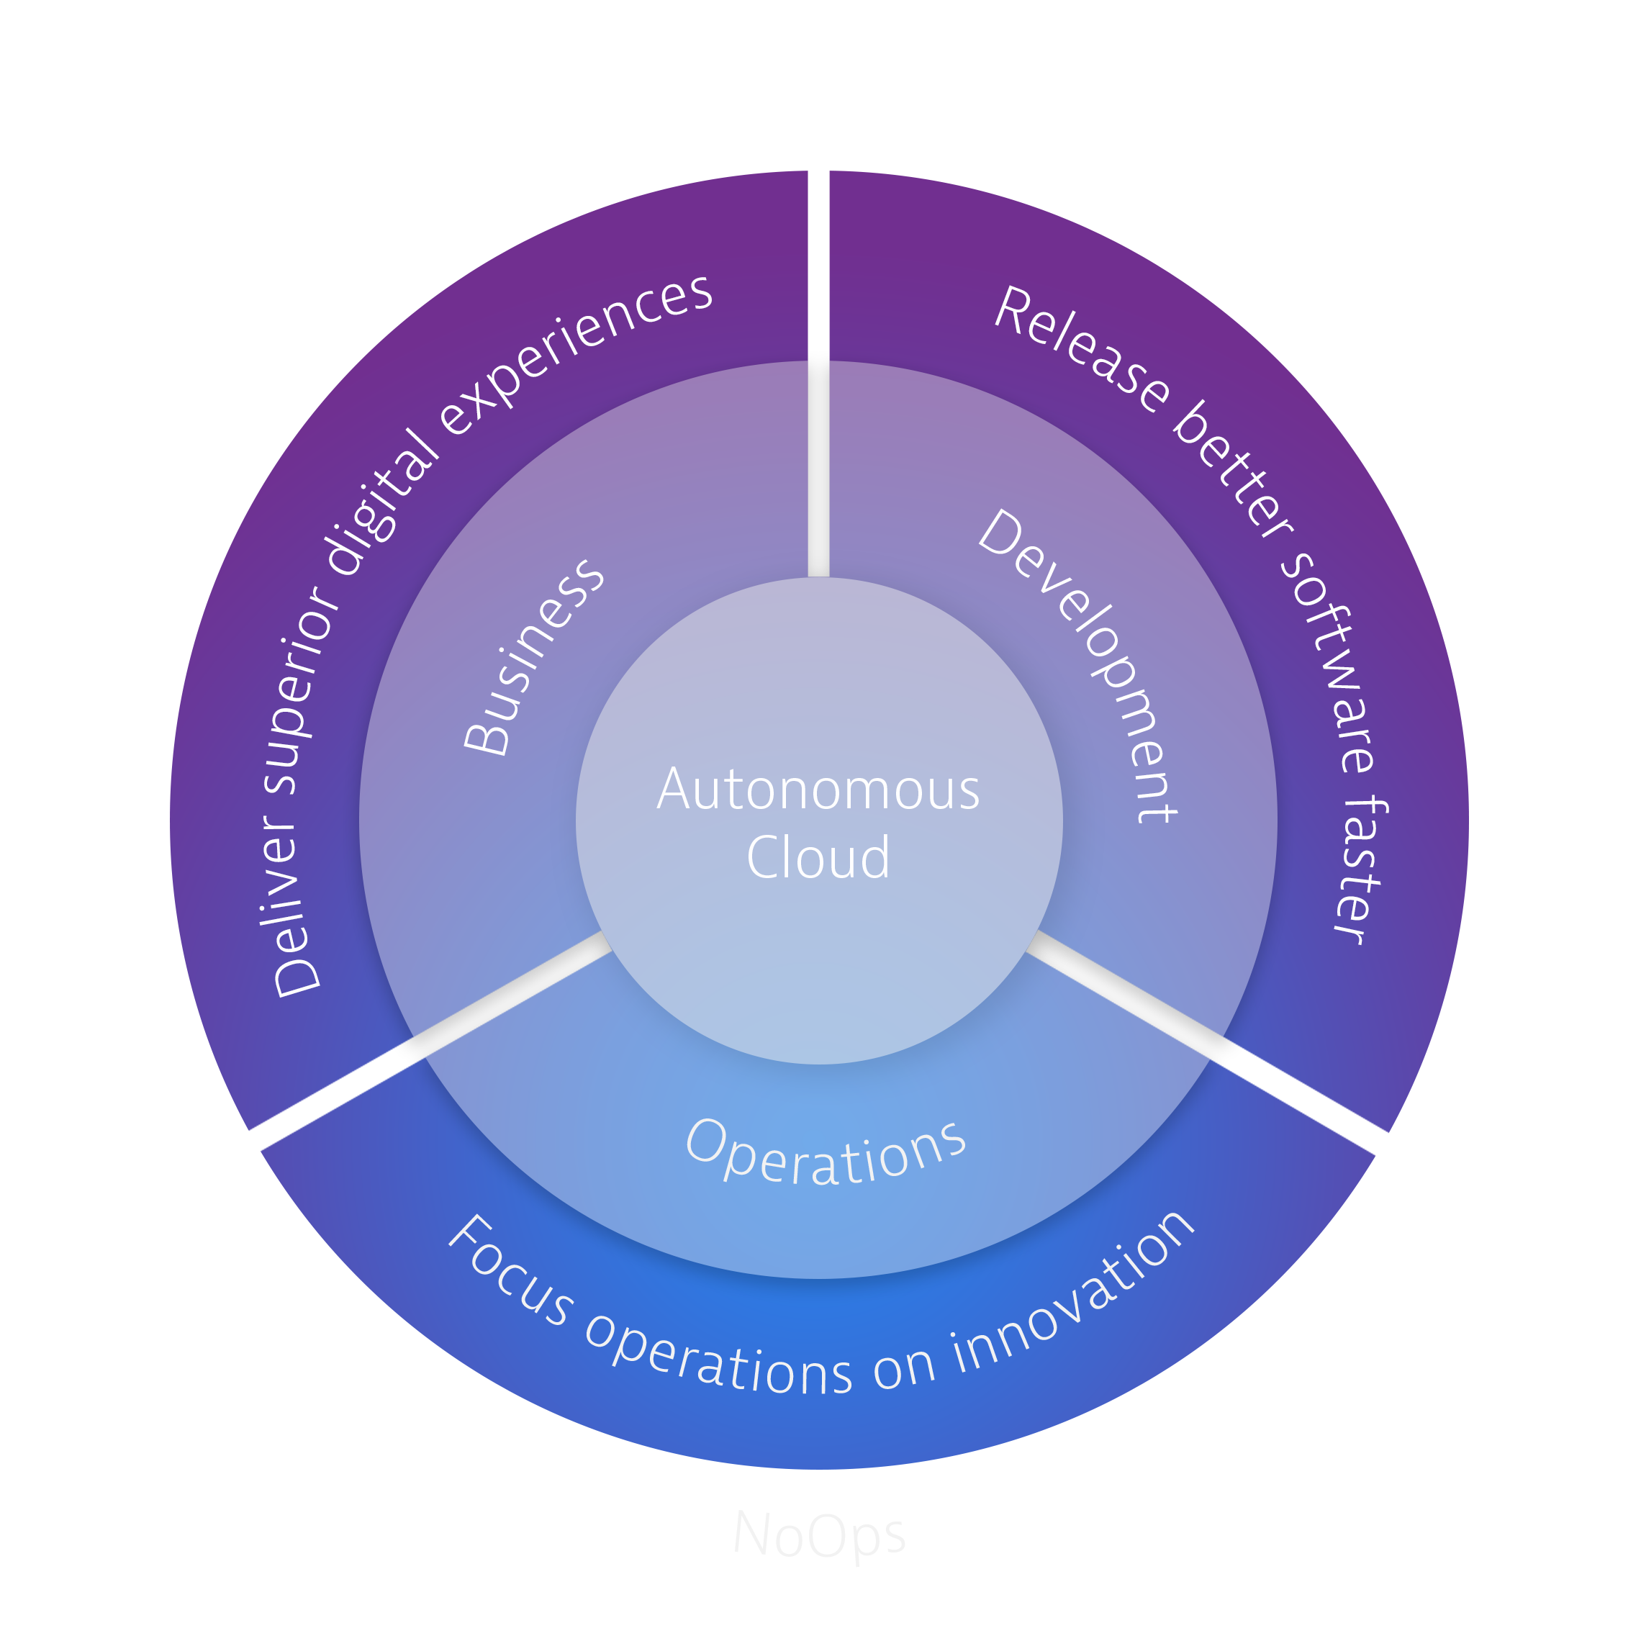
Autonomous Cloud Enablement
Automation Services
Monitoring as a Service
Automated Quality Gates
Automated Incident Management
Automated Problem Remediation
Like what you saw today?
Visit the Innovation Expo or University booth for more information.
www.dynatrace.com/services-support/autonomous-cloud-enablement/

Slide 31
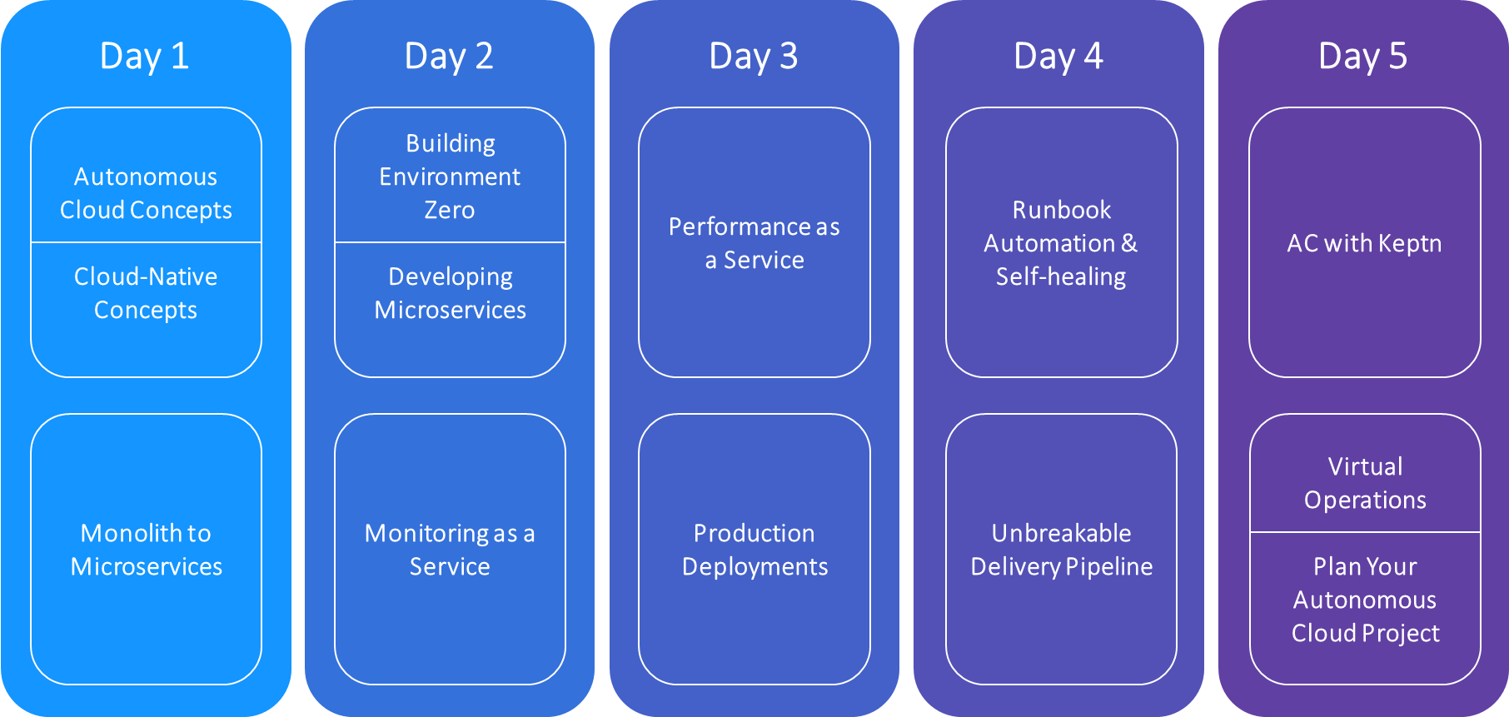
Autonomous Cloud Enablement
Autonomous Cloud Labs
It not just a training…it’s an immersive lab experience
Like what you saw today?
Visit the Innovation Expo or University booth for more information.
www.dynatrace.com/services-support/autonomous-cloud-enablement/

Slide 32

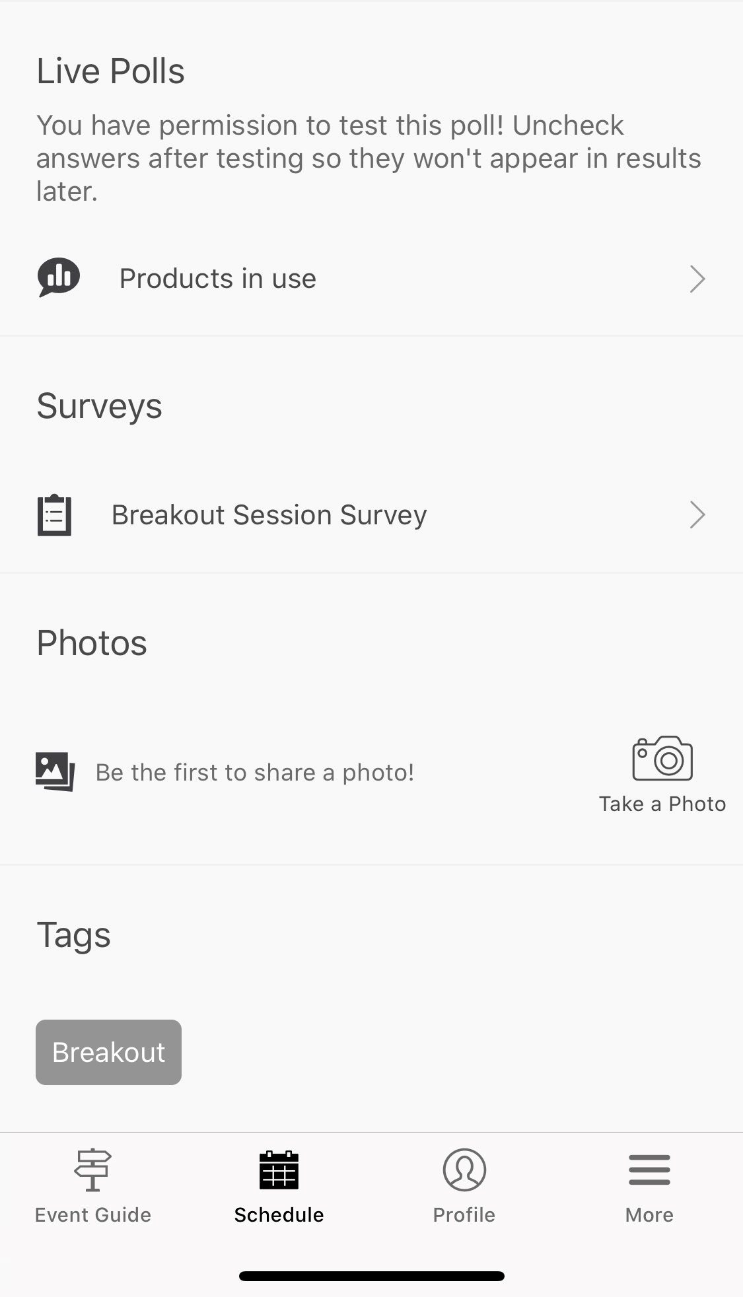

Please tell us how we did!
2 minute survey
Go to the session in the Perform app (under Schedule)
Scroll down to Surveys
Your feedback is important to us

Slide 33
Join the Community
https://github.com/keptn/community
@keptnproject
keptn@dynatrace.com
keptn.slack.com
Biweekly community meetings
Zoom https://dynatrace.zoom.us/j/578828410
Notes https://tinyurl.com/keptn-meeting-notes

